Slide 1
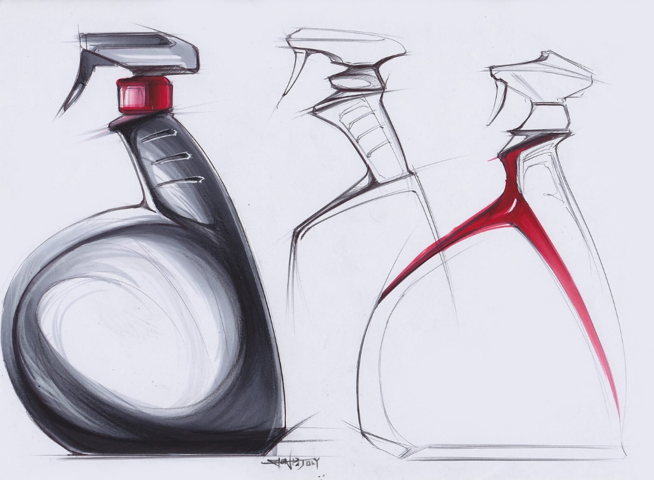
nat5 Design & Manufacture
Course Introduction

Slide 2
Welcome to nat5 design & manufacture
This year you will be introduced to several new topics related to the design process as well as practical skills and techniques, and materials and commercial manufacturing processes.
The course is split into three main units:
Design
Materials and Manufacture/Processes
Course Assignment
During the course, you will complete a number of design projects as well as attain the necessary skills for working with plastic, metal and wood by completing several practical projects.

Slide 3
DESIGN
The first main topic in the course is design. You will develop your skills and creativity by designing products and manufacturing them.
You will study the following topics to enable you to produce a successful design folio throughout the year:
The Design Team (who is involved in the design process)
The Design Process (brief, product specification, ideas, development)
Design Factors (e.g. function, aesthetics, ergonomics, safety)
Idea Generation Techniques
Graphics in the Design Process (preliminary, production and promotional graphics).
Modelling Techniques (card/cardboard//foam/computer modelling)
Environmental Considerations
Evaluation (of products and your designs).
You will also develop useful techniques such as physical modelling (card/paper/cardboard), 3D modelling (Inventor) and sketching techniques in both 2D and 3D.

Slide 4
Materials and manufacture/processes
The second main topic is materials and processes (manufacture). You will study the properties, uses and commercial manufacturing processes involved in producing products in the following areas:
Wood
Metal
Plastic
For each of the above topics, you will be required to know the properties of different materials; the tools, machines and commercial processes used to manufacture products from those materials; identifying features of products.

Slide 5
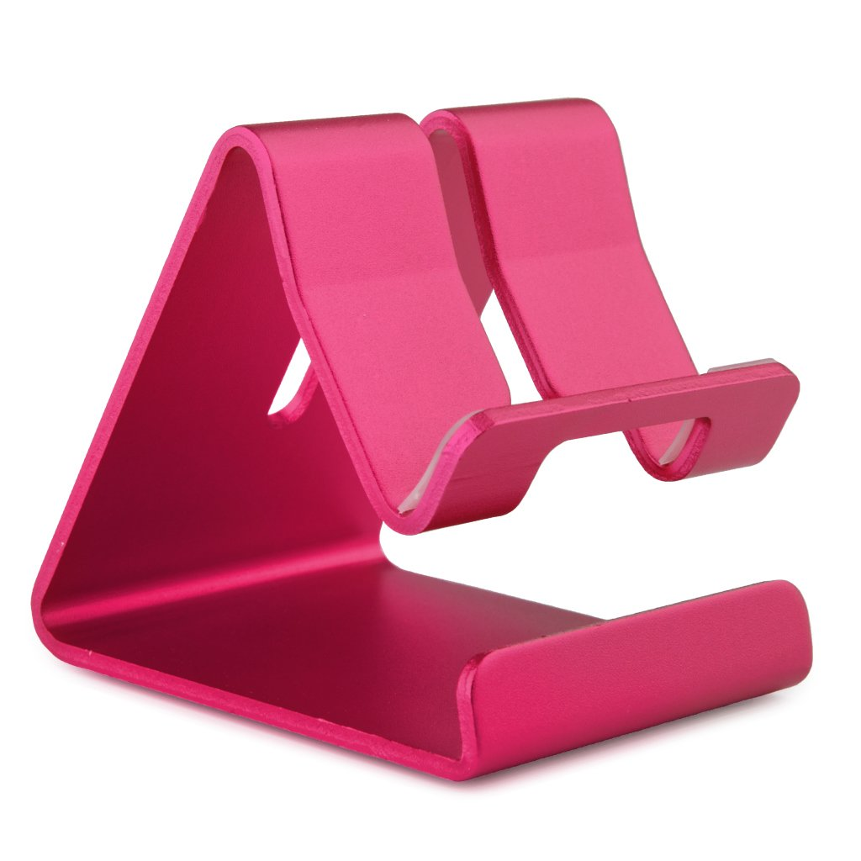
Project 1 Phone holder
The course is split into 4 projects to give you experience of both design work and manufacturing in plastic, metal and wood.
The first project is the design and manufacture of a plastic phone holder.
You will use your knowledge from the theory and design techniques lessons to start your own phone holder design folio.
Before you make your final design, you will get practice in working with plastic in the workshop, by completing a small pencil holder project.
When you have completed this, you will manufacture your final design in acrylic (plastic).

Slide 6
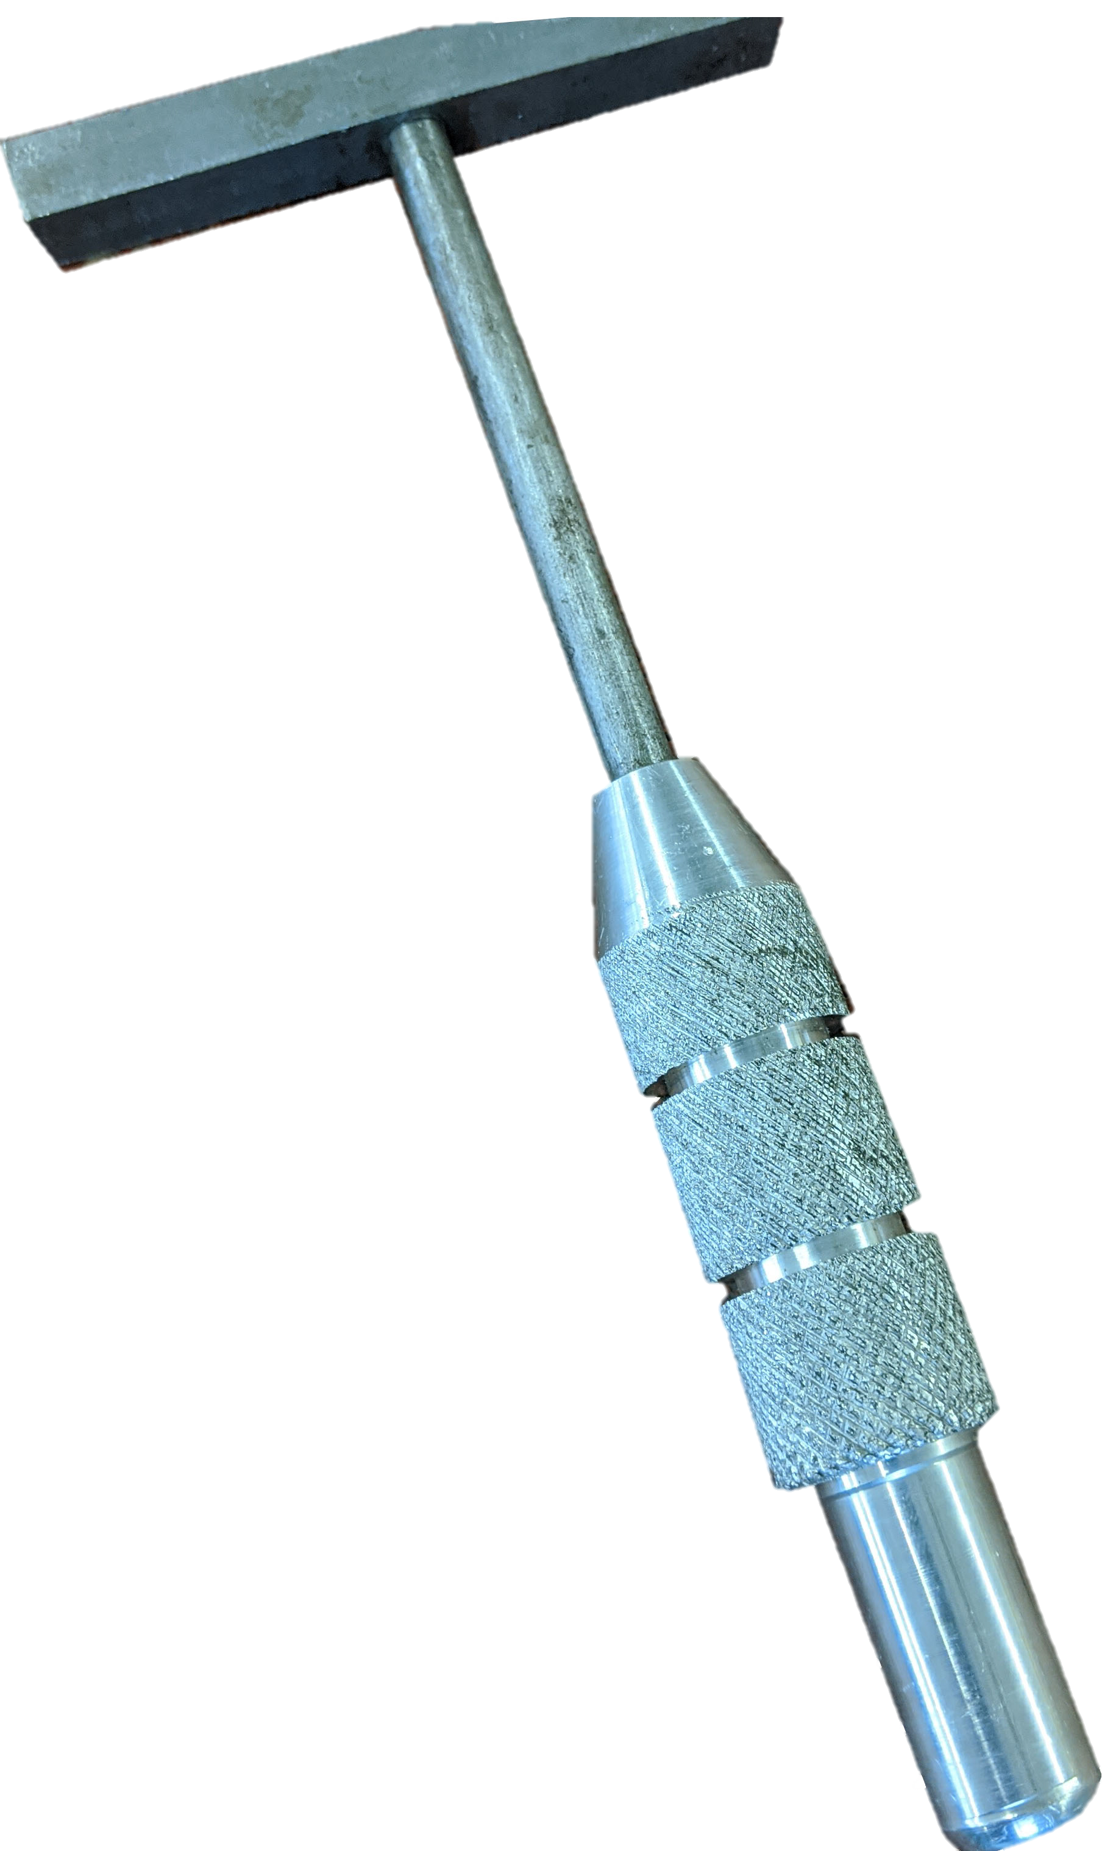
Project 2 toffee hammer
The second project is the manufacture of a toffee hammer.
Prior to entering the workshop, you will learn about the different properties and commercial processes of different metals.
The hammer has already been designed, therefore this is a project to allow you to learn all about the different hand tools, machine tools you will use in the workshop.
You will be required to accurately read working drawings, mark out, cut, file and finish metal. You will also be required to add screw threads and produce the hammer handle on the metal lathes, through eight different processes.

Slide 7
Project 3 Wood frame
The third project will require you to develop your skills in woodwork.
You will complete a number of practise joints in the workshop and familiarise yourself with the tools, processes and different wood types and their properties.
Your final test will be to follow working drawings, mark out the joints on the wood and manufacture a frame. You will have minimal assistance to complete this, however you will receive help if required to complete it.

Slide 8
Project 4 s3 design assignment
The final project in S3 will be presented to you in more detail in February. You will be asked to select one of three different design briefs.
From this, you will complete an 8 page design folio in class, using all your knowledge and design skills attained from previous lessons.
Once your folio is complete, you will then go on to manufacture this in the workshop to produce a finished prototype.
The project is open book, which means you can use sources such as class notes, books, magazine, the Internet and ask your teacher.

Slide 9
Course assessment
The S3 folio is a “practise” for the final National 4/5 course assignment. Should you continue to study Design & Manufacture in S4, you will need to complete an assignment (Nat4 is issued by the teacher, Nat5 is issued by the SQA).
In both S4 assignments, you will be asked to choose a design brief, develop a proposal in the form of a design folio, and manufacture a working prototype.
Overall, the course is assessed as follows:
Course assignment/Added Value Unit = 55% of the total marks.
Final SQA Exam (knowledge and understanding of the course theory) = 45% of total marks.

Slide 10
careers
There are a number of different careers that Design & Manufacture could lead you to, such as:
Aerospace engineer
Agricultural engineer
Aircraft maintenance engineer
Architect
Architectural technician
Architectural technologist
Automotive engineer
Blacksmith
Carpenter or joiner
Chemical engineer
Civil engineering technician
Construction manager
Costume designer
Electrical engineer
Furniture designer
Games developer
Set designer
And many more…
To see a full list of potential careers, click on the link below:
https://www.myworldofwork.co.uk/my-career-options/subjects?group=all&subjects=2991

Slide 11
YOUR NAME (BIGGEST THING ON THE PAGE)
S3 DESIGN AND MANUFACTURE
MR. PORTER
INCLUDE DESIGN IDEAs, PRODUCTS, LOGOS, GEMOETRIC SHAPES ETC.

